Slide 1
Component Object Model (COM)

Slide 2
Why COM?
Langauge Independency/Binary Reusability ( ex: common data type, similar memory layouts e.t.c )
Location Transparency (ex: Remote servers using DCOM)
Loose Coupling ( Issues with normal .h/.lib concepts. Mangled names while developing with C++)
EXE server’s are difficult to write
DLLs cant be used with interpreted languages such as VBScript.

Slide 3
.h File
    Class CFun
    {
    public:
    int SayHello(CString cMsg);
    private:
    CString m_prvtString:
    }
.CPP File
    int CFun::SayHello( CString cMsg )
    {
    m_prvtString += cMsg;
    AfxMessgeBox( m_prvtString );
    }

Slide 4
IUnKnown – The basic Com Interface
AddRef()
Release()
QueryInterface()

Slide 5
The terms to be noted
Vtable in C++
IDL (Interface Definition Language) and MIDL
InProc/OutProc Servers
Class Factories to Create objects
IDispatch interface for Automation
COM runtime and Marshalling
Windows Registry
Threading Models (Apartment/MutliThreaded)

Slide 6
Interface Definition
GUID CLSID_IFun = { 5078FFB2-D553-4867-B9AE-946D523DACBC };
GUID IID_IFun = { 7078FFB2-D5E3-4867-A9AE-946D523DACB9 };
    interface IFun: IUnknown
    {
    HRESULT SayHello(BSTR bstrMsg);
    }
Interface Implementation
    Class CFun : IFun
    {
    public:
    HRESULT QueryInterface( REFIID riid, void **ppvObject);
    ULONG AddRef();
    ULONG Release();
    HRESULT SayHello(BSTR bstrMsg);
    private:
    CString m_prvtString:
    int m_RefCount;
    }
    Implement the class in the CPP file

Slide 7
Class Implementation
    HRESULT CFun::SayHello( BSTR bstrMsg )
    {
    m_prvtString += CString(bstrMsg);
    AfxMessgeBox( m_prvtString );
    }
    ULONG CFun::AddRef()
    {
    m_RefCount++;
    }
    ULONG CFun::Release()
    {
    if( --m_RefCount <= 0 )
    {
    delete this;
    }
    }

Slide 8
Class Implementation Contd…
    HRESULT CFun:: QueryInterface( REFIID riid, void **ppvObject)
    {
    if( riid == IID_IUnKnown)
    {
    *ppvObject = static cast<IUnKnown*>(this);
    AddRef();
    retrun S_OK;
    }
    else if (riid == IID_IFun)
    {
    *ppvObject = static cast<IFun*>(this);
    AddRef();
    retrun S_OK;
    }
    retrun E_NO_INTERFACE;
    }

Slide 9
    Class CFunFactory : IClassFactory
    {
    public:
    HRESULT CreateInstance (IUnknown *pOuterUnk,
    const IID& iid,void ** ppv);
    HRESULT LockServer (BOOL bLock);
    private:
    int m_RefCount;
    }
    HRESULT CFunFactory :: CreateInstance(IUnknown *pOuterUnk,
    const IID& iid,void ** ppv)
    {
    if( riid == IID_IFun)
    {
    CFun *objPtr = new CFun;
    IUnKnow* unknowPtr = static cast<IUnKnown*>(objPtr);
    if(unKnowPtr->QueryInterface(iid,ppv) == S_OK)
    {
    retrun S_OK;
    }
    }
    retrun E_NO_INTERFACE;
    }

Slide 10
    Client Code
    IFun* p;
    CoCreateInstance( CLSID_IFun , IID_IFun , &p);
    P->SayHello();
    P->release();

Slide 11
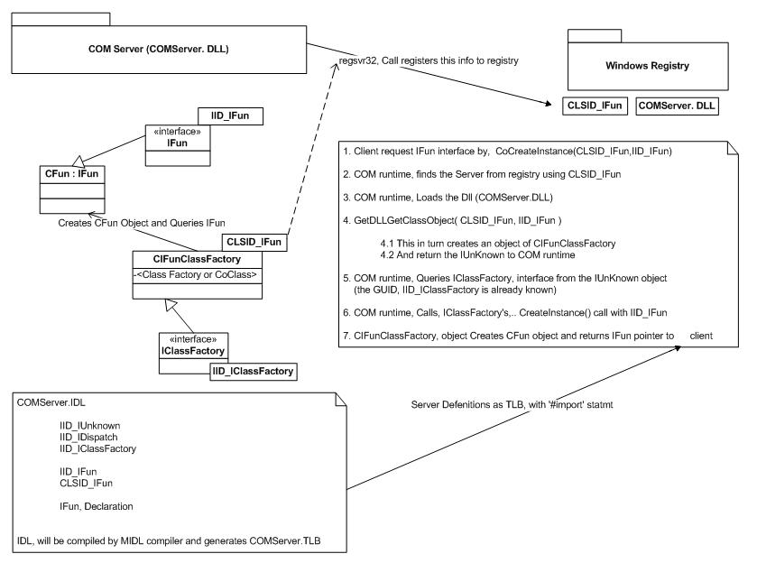

Slide 12
How COM object Created
CoCreateInstanceEx(CLSID_IFun,0,CLSCTX_INPROC_SERVER,0,IID_IFun,(void**)&ptrIFun);
Server Name, Class ID and are registered in Window Registry.
COM runtime, Starts/Load the component and Calls its DllGetClassObject(), to get the class factory with CLSID_IFun and IID_IClassFactory
COM runtime, calls the CreateInstace of the classfactory instace with IID_IFun
which in turn returns the reference to the CFun object through IFun pointer
Client uses IFun* p; ex: p->SayHello(_bstr_t( “Hai” ));
Client releases IFun pointer, i.e p->Release()
COM runtime unload the DLL, If reference count is 0

Slide 13
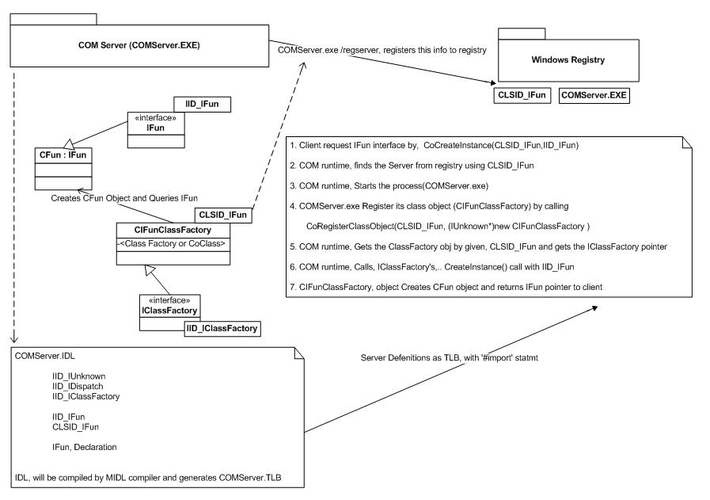

Slide 14
ATL and Its advantages
Active Template Library
Relives us, from the implementations of IUknown
Relives us, from creating Class Factories
Relives us, from registering/un registering of interfaces and ClassFactories
Relives us, from Creating IDL
Gives Wizard to add, Interfaces and methods

